Slide 1
IST 722
FINAL PROJECT PRESENTATION
HALEY BROWN
REBECCA KARUNAKARAN
KYLE WOJTASZEK

Slide 2








TABLE OF CONTENTS
Project charter
Business Process
Star Schema
Pivot/Power BI Visuals
Summary
Recommendations

Slide 3

PROJECT CHARTER
OVERVIEW
FudgeMart, a retail corporation, and Fudgeflix, a movie rental service, have decided to merge into a new company, Fudge Inc.
As a result, management want to consolidate data from the two companies into a single system in order to make informed analysis and business decisions.
OBJECTIVE
To implement an integrated Data Warehouse, bringing together data from both enterprises. Additionally, we will use that data warehouse to create BI reports to meet the needs of our business processes. The project will be deployed for use by late June 2019.

Slide 4
BUSINESS PROCESSES
SIMPLE
FUDGEFLIX QUEUE REPORTING
View queues by:
Day of week
Title rating (G, PG, PG-13, etc.)
Queue to ship (for physical dvd shipments)
FUDGEMART SHIPMENT PROCESS
View time from order to ship
COMPLEX
CONSOLIDATED SALES REPORT
View sales (quantity, price, and order total) by
Customer
Department and/or product
Location (city, zip code, state)
Year
CONSOLIDATED CUSTOMER REPORT
View average ratings of products or titles per customer
INDICATES A FULLY MODELLED PROCESS

Slide 5
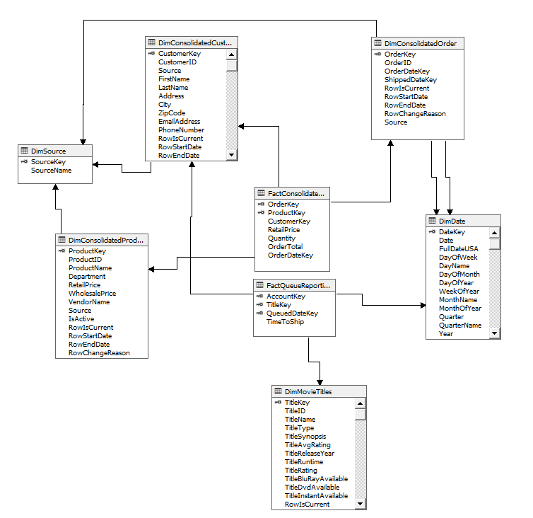
STAR SCHEMA

Slide 6
GLOBAL SALES
SALES NUMBERS HAVE DROPPED FROM 2009 WITH A STEEP DROP IN 2012
Definitely a concern for upper management and future of company
SALES VOLUME IN THE COASTAL STATES ARE HIGHER THAN IN THE MIDDLE OF THE COUNTRY
Potential to expand customer base to these areas
ELECTRONIC PRODUCTS DOMINATE THE SALES (67%)
Need to improve sales in other departments through new marketing campaigns and sales promotions

Slide 7
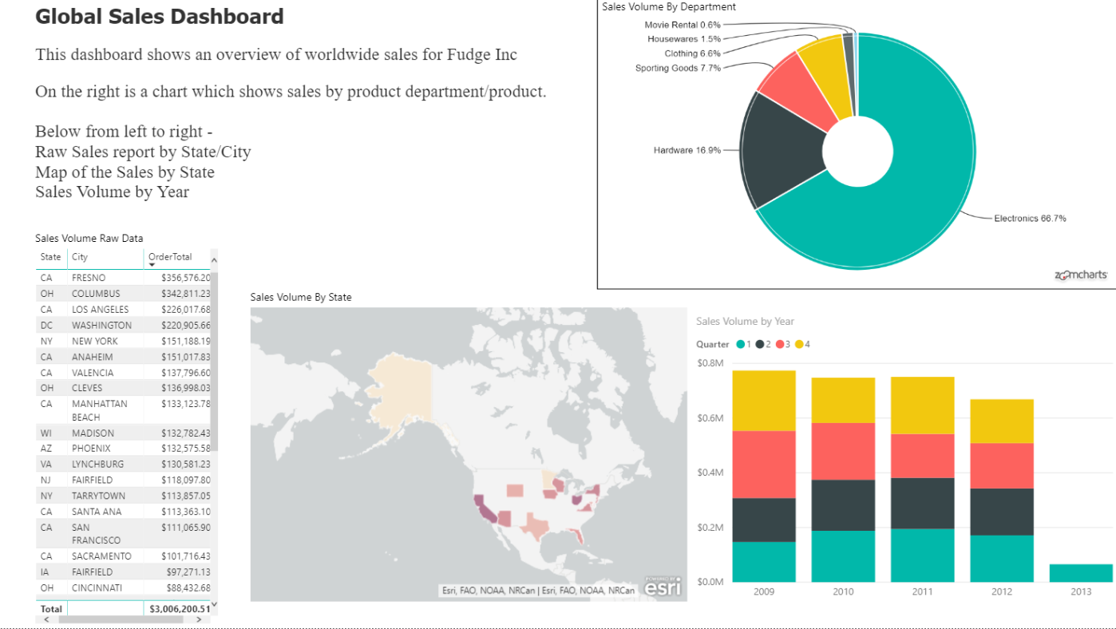
BI REPORT 1 - CONSOLIDATED SALES RE

Slide 8
QUARTERLY AND STATE DASHBOARDS
Displays sales per year/quarter AND state
Provides some different metrics than the global sales dashboard, including average order amount ($) and order counts
Matrices provide specific details for visualized data

Slide 9
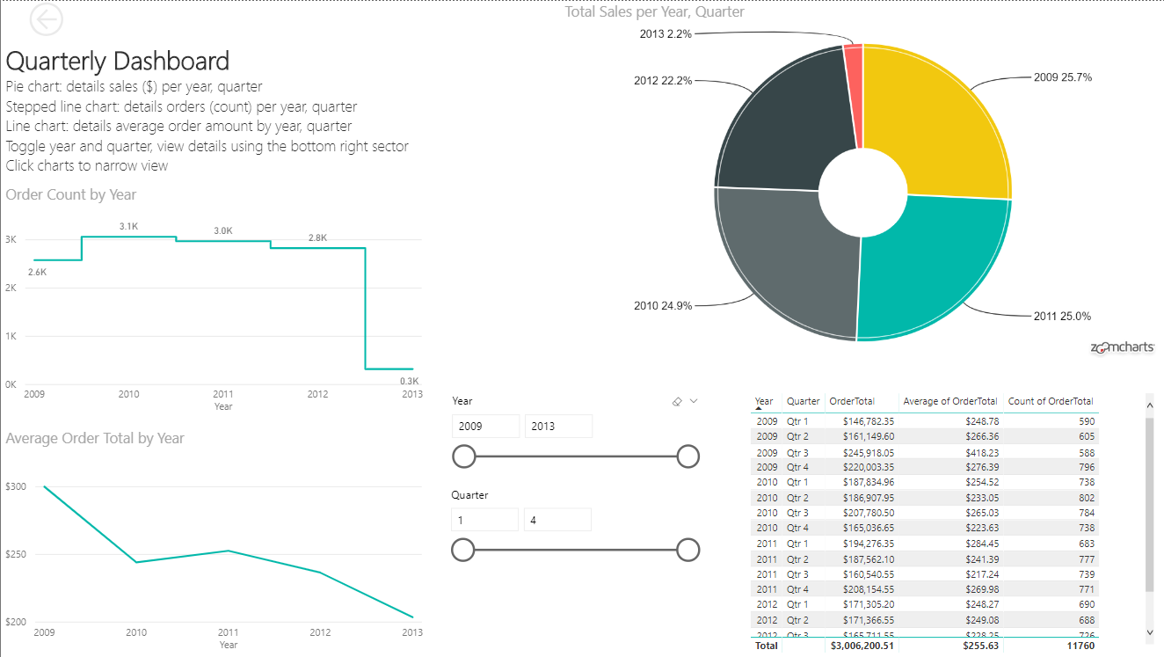

Slide 10
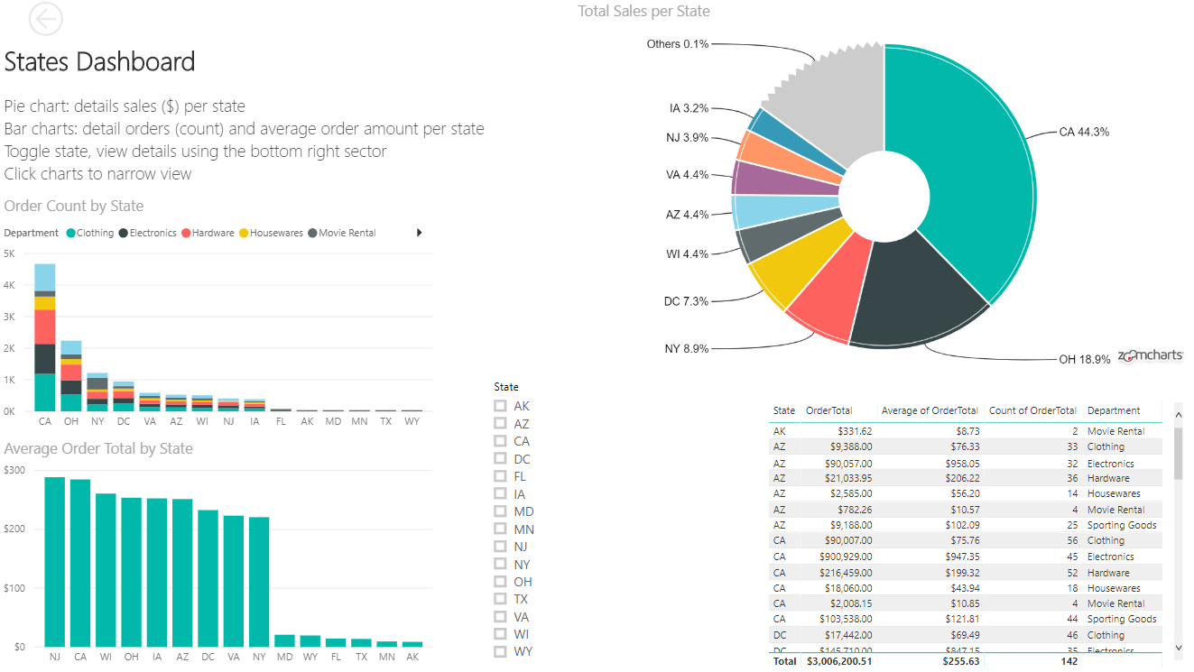

Slide 11
QUARTERLY AND STATE DASHBOARDS -
TAKEAWAYS AND RECOMMENDATIONS
The average order total in 2012 dropped to about $236. If this trend continues into 2013, marketing should consider promotions and incentives that will boost the average order amount. Possible incentives include free shipping for orders over $250 or BOGO deals
The number orders per year is also down slightly from 2011 to 2012. If trend continues, marketing can also create incentives for customers to make future orders. Possible incentives include discounts on the next order or implementation of a points program where customers earn points for each order.
California, Ohio, and New York are states with the top sales in both dollar amount and order count. Fudge Inc has several up and coming states however. Management needs to boost sales in these states and states not currently represented by our customer base.

Slide 12
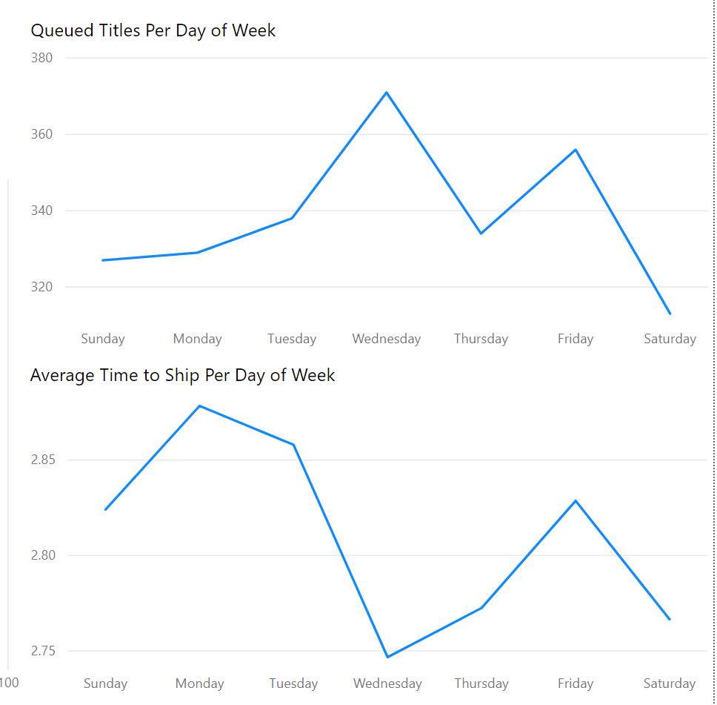
FUDGEFLIX MOVIE QUEUE
Time To Ship
Days between a movie being queued and a movie being shipped
Most popular days for queuing are Wednesday and Friday
Perhaps prepping for the weekend
Time to Ship suffers on Monday and Tuesday
Approximately .1 days longer than average of other days
1 out of every 10 queued movies takes 1 day longer than average.
Recommend increasing warehouse staffing on Monday and Tuesday to alleviate issues.
Increase inventory of popular movies

Slide 13
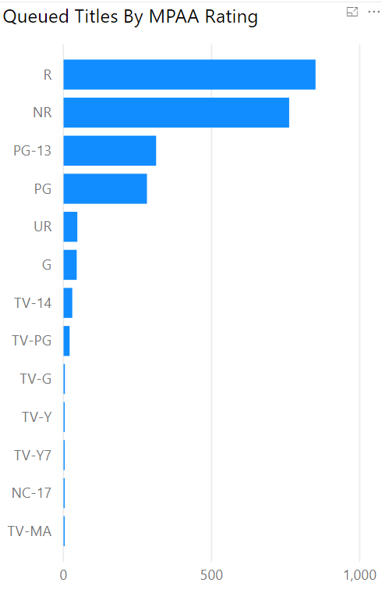
FUDGEFLIX MOVIE QUEUE
R-rated movies are most popular
Followed by PG-13, PG, G
Must continue to ensure sufficient stock of R-rated movies to meet demand
Many good PG and PG-13 rated movies exist
5 of top 10 movies of 2018 on Rotten Tomatoes^{[1]}
Need more marketing around family-friendly content
Potential to appeal to new customers
[1] - https://www.rottentomatoes.com/top/

Slide 14
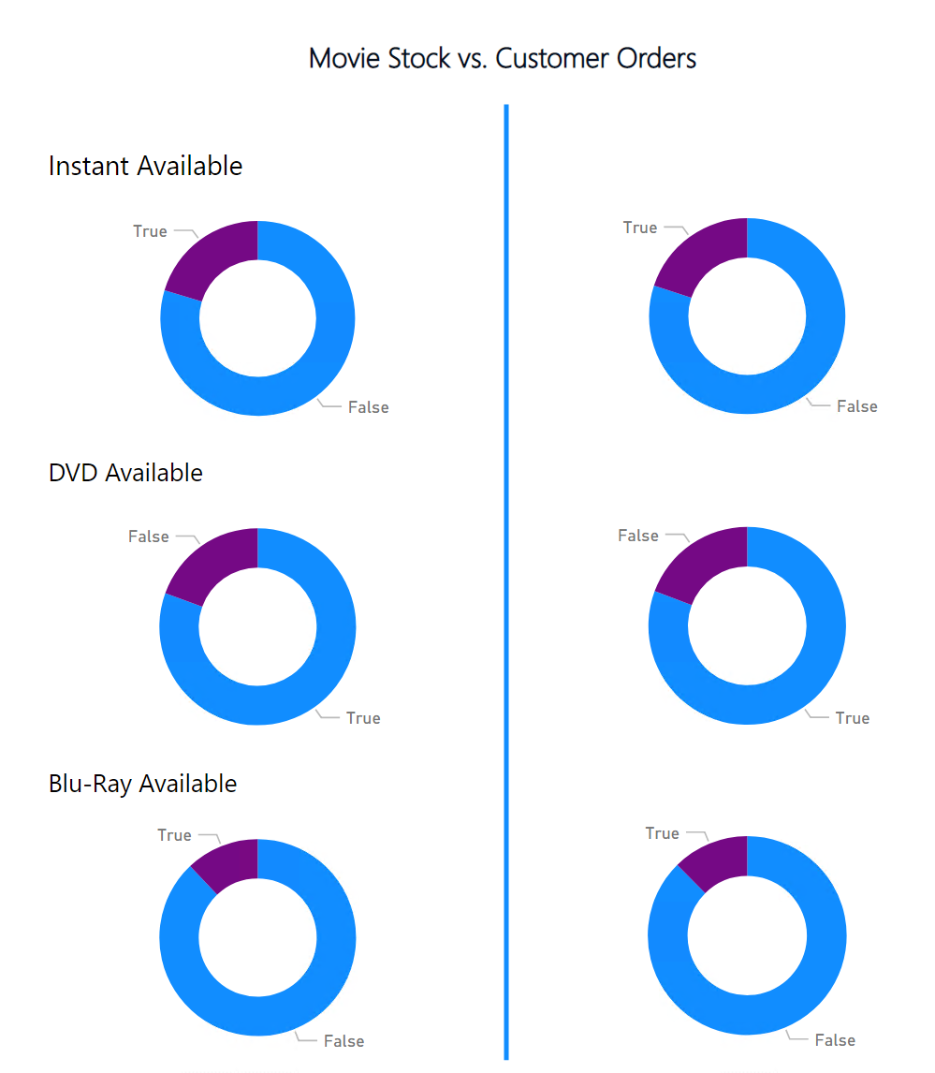
FUDGEFLIX MOVIE QUEUE
Current Inventory is in line with demand
Inventory and Orders are within 1% of each other across all media types
Over 4,000 movies available instantly
Over 17,000 movies available on DVD
Over 2,500 movies available on Blu-Ray
Movie Streaming is becoming more popular over time
Need to monitor this report to ensure we do not fall behind demand

Slide 15
RECOMMENDATIONS - Fudgeflix
Increase staffing on Monday and Tuesday in the warehouse to improve time to ship
If delays are caused by movies needing to be returned from the weekend, increase stock of more popular movies
Market towards families to increase demand for PG and PG-13 movies
Continue to monitor streaming trends to ensure we are meeting customer needs

Slide 16
RECOMMENDATIONS - Fudge Inc.
Sales numbers have dropped since 2009, indicating a need to expand customer base. The target area is middle states (where we currently have no customers) and up-and-coming states, where we have a few customers, but can easily build more.
Our BI layers also indicate a need to promote sales in lower performing product departments like housewares, clothing, and sporting good, which currently comprise less than 35% of total sales volume.
Order count and average order amount were down in 2012. Customer incentives to purchase more per order and place higher order counts are needed.

Slide 17
Questions/Comments?

